Slide 1
Stewart Platform for Object Balancing
MAE 547 FINAL PROJECT
Tabsheer Askari Siddharth Jain Harshal Sanghvi Ketan Choudhary Harshil Shah

Slide 2
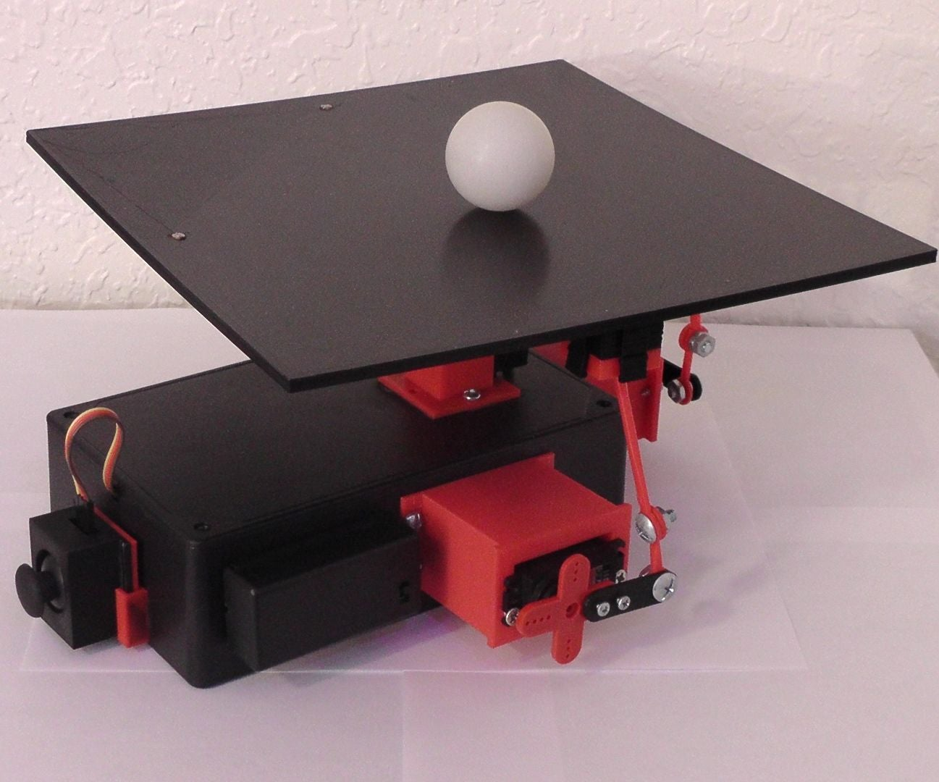
Problem Statement
Our problem statement revolved around creating a
A ball balancing platform
Designing a PID controller for faster convergence

Slide 3
Stewart Platform
We decided to use a Stewart Platform that gave us 6 degrees of freedom using 6 prismatic actuators and 12 universal joints.
This gave the top platform six degrees of freedom wherein it is possible for a freely-suspended body to move: three linear movements x, y, z (lateral, longitudinal, and vertical), and the three rotations (pitch, roll, and yaw).

Slide 4
Algorithm
Start
Is ball at the center of the platform?
No
Calculate the distance from center in X and Y axis
Adjust platform orientation
PID Controller
Yes. End simulation

Slide 5

Equations & Calculations
Ball position and velocity & Platform position and orientation are used to calculate the Euler angles using the above matrix
The derivative the Euler angles are used to compute the position and velocity using the inverse kinematics equations.
These values are used to control the platform angles via our PID controller.
Euler Angle Calculations
$$\begin{matrix}cos(u[2])∗cos(u[3]) & −cos(u[2])∗sin(u[3]) & sin(u[2]) \\ cos(u[3])∗sin(u[2])∗sin(u[1])+cos(u[1])∗sin(u[3]) & cos(u[1])∗cos(u[3]) − sin(u[1])∗sin(u[2])∗sin(u[3]) & −sin(u[1])∗cos(u[2]) \\ sin(u[1])∗sin(u[3]) − cos(u[1])∗cos(u[3])∗sin(u[2]) & cos(u[3])∗sin(u[1])+cos(u[1])∗sin(u[2])∗sin(u[3]) & cos(u[1])∗cos(u[2])\end{matrix}$$

Slide 6
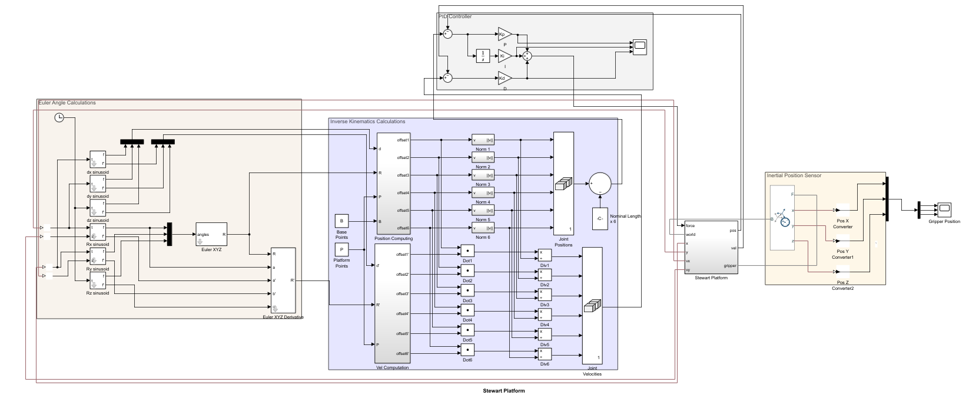
Simulink Model

Slide 7
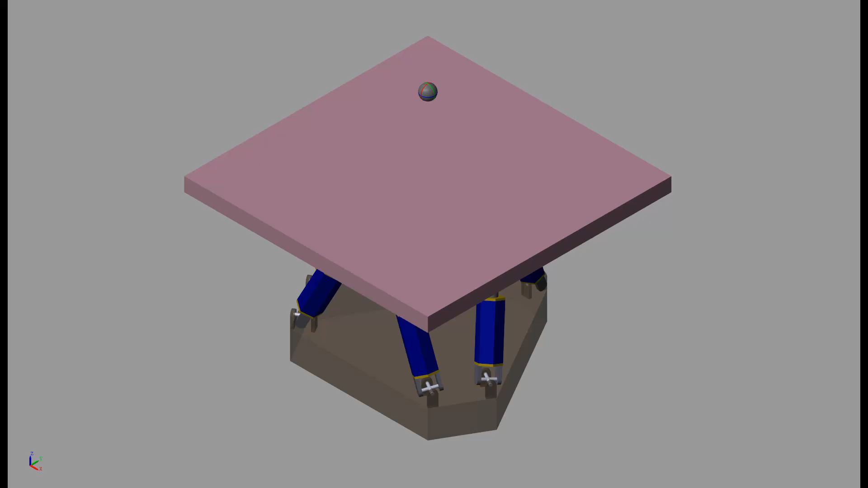
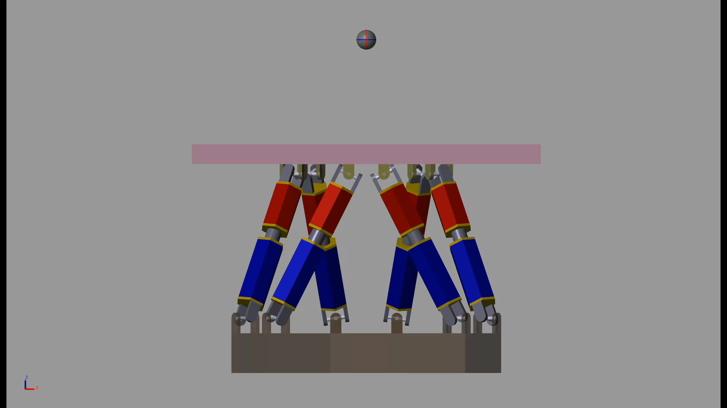
Simulation
Ball centered on the platform

Slide 8
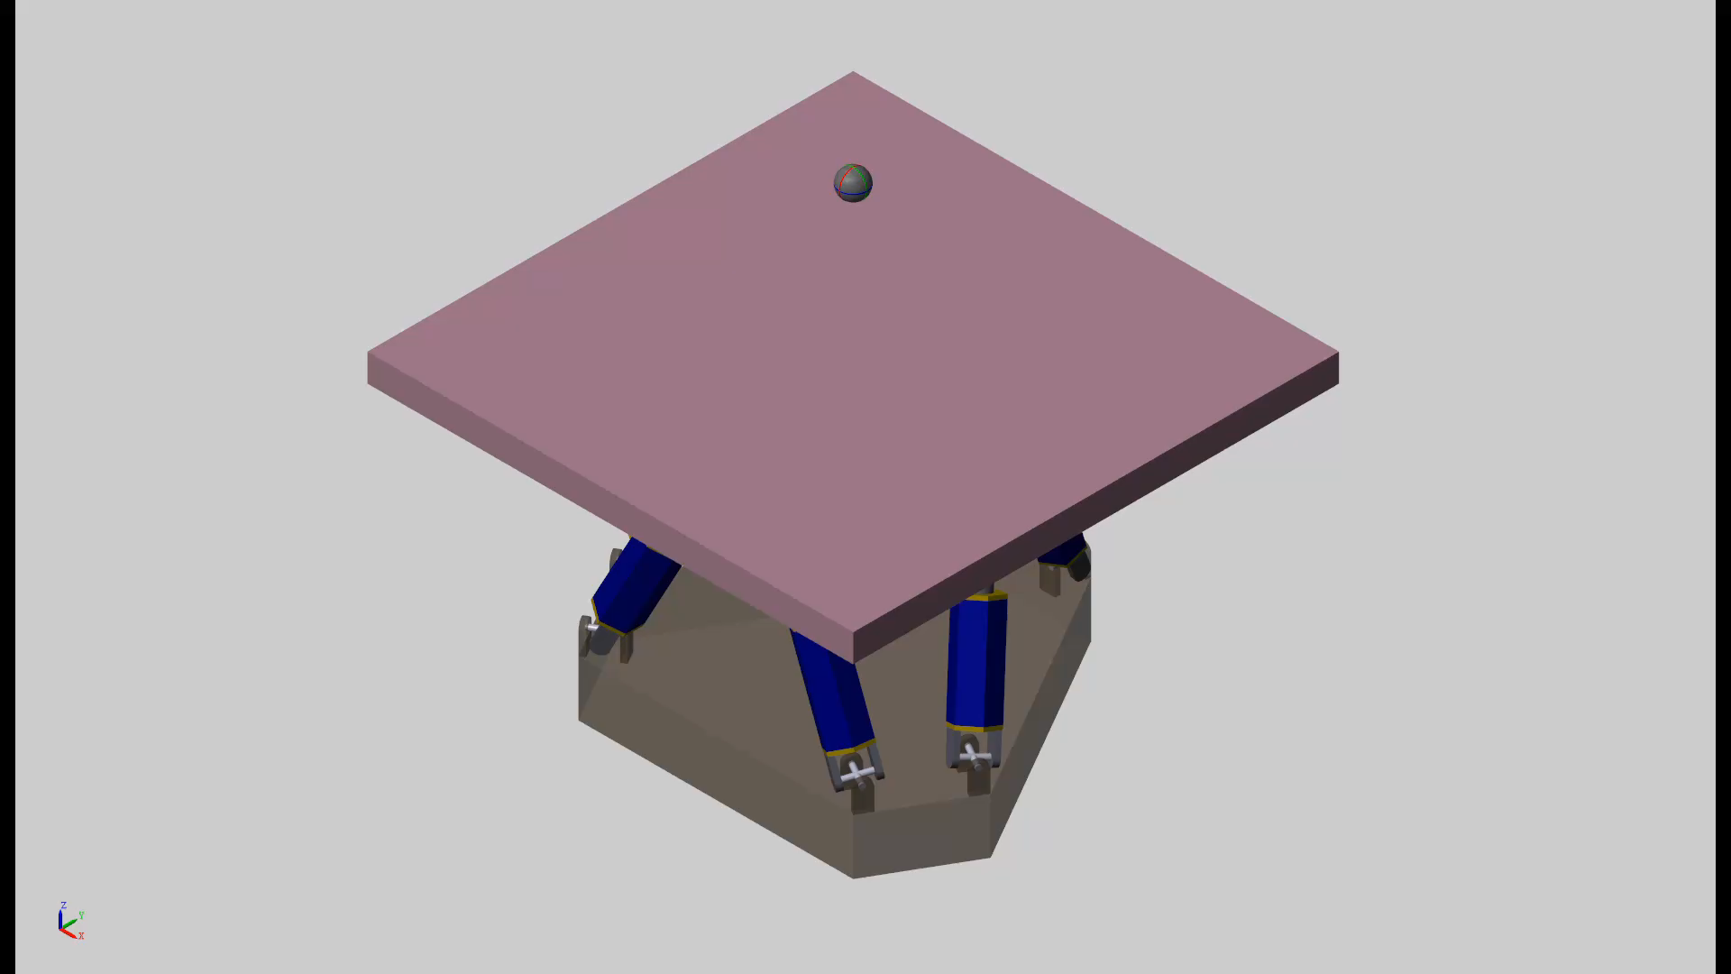
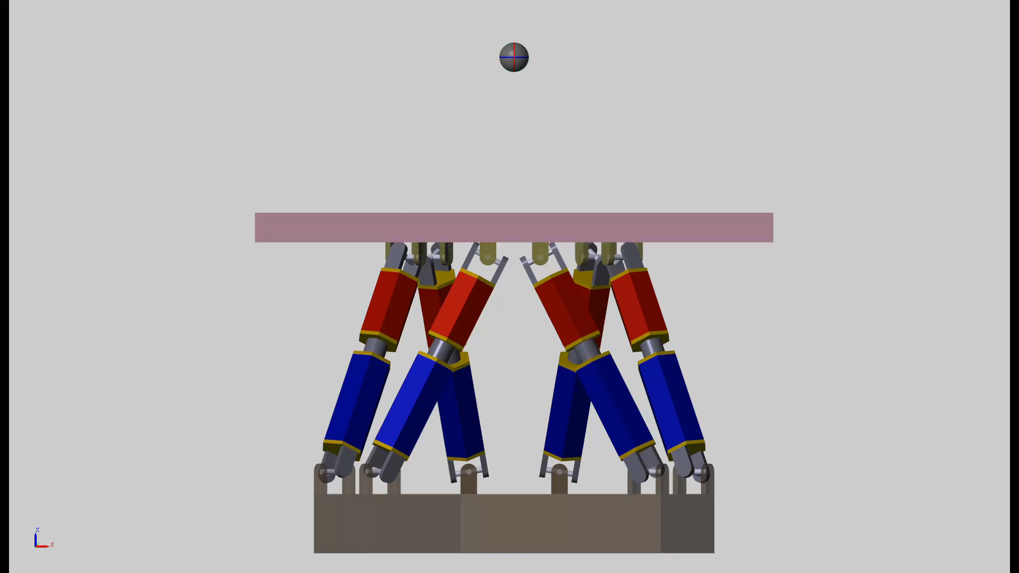
Simulation
With perfect PID tuning, the ball is centered even when it lands on the edge of the platform

Slide 9
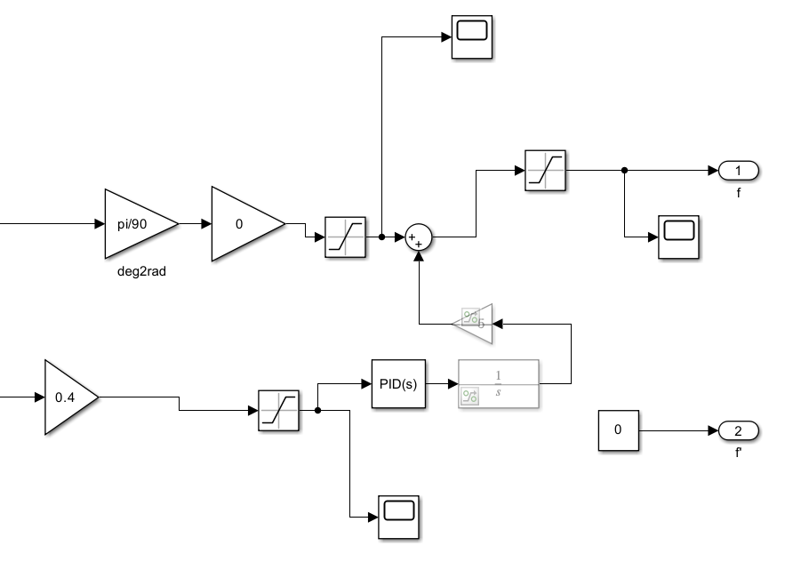
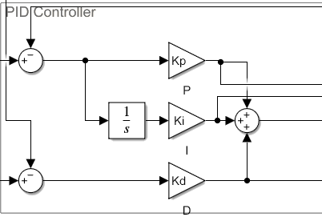
PID Controller
PID for platform orientation in X and Y axis
PID for error minimizing between actual and desired position

Slide 10
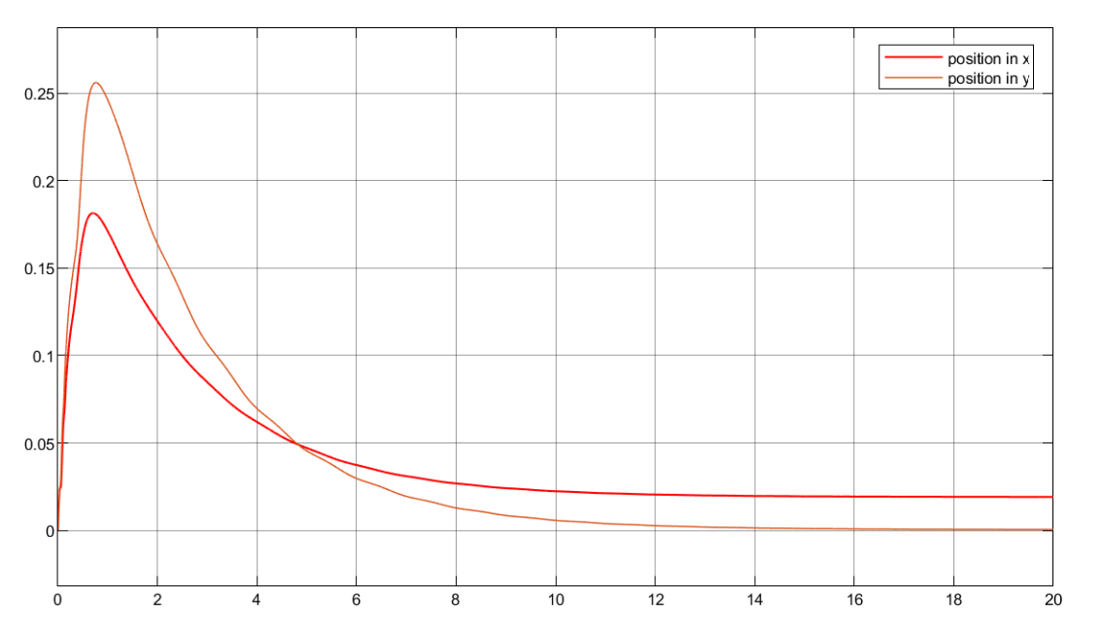
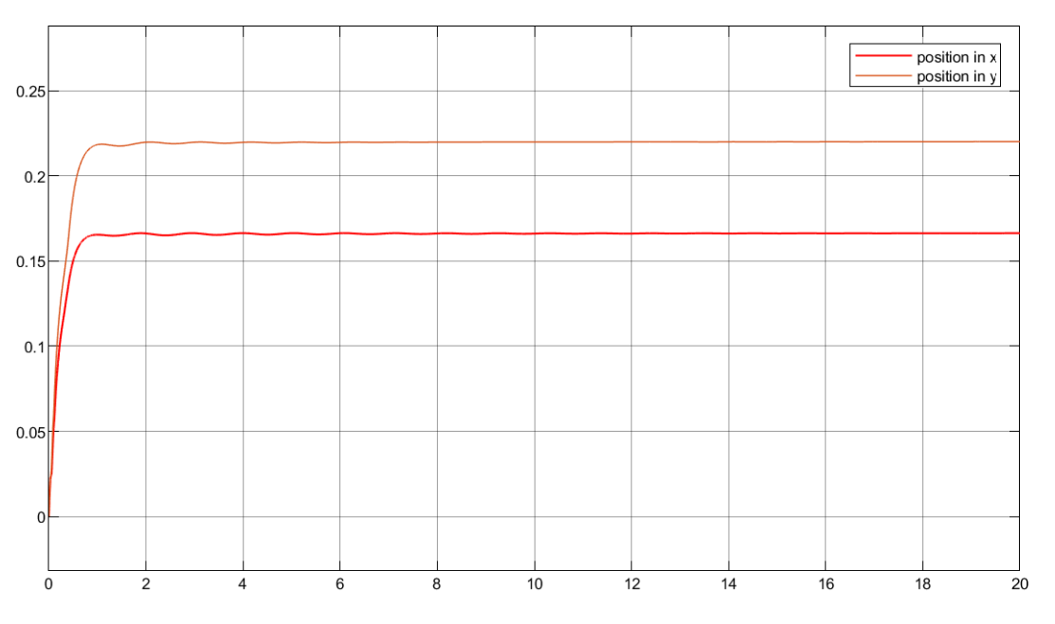
With and without PID
Ball balanced on plate with PID controller denoted by position along x and y axis
Steady State Error due to absence of integral action

Slide 11

PID Controller
When the integral value is set to zero
When the derivative value is very high

Slide 12
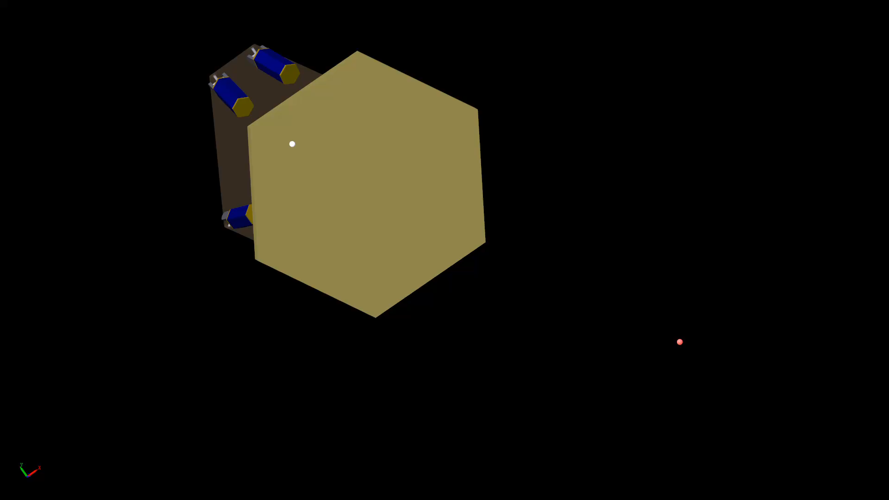
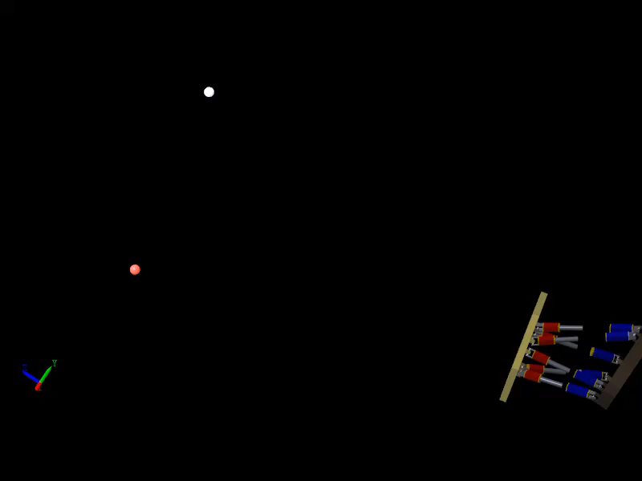
New Implementation
Platform is made to turn towards a random point in space. (JWST implementation)

Slide 13
Run our model
Running the model is straightforward since every command needed is in the matlab script itself.
Extract the zip file
Run the “execute_model_2020a.m” file provided.
Simscape Multibody Contact Forces Library is used
Link - https://www.mathworks.com/matlabcentral/fileexchange/47417-simscape-multibody-contact-forces-library

Slide 14
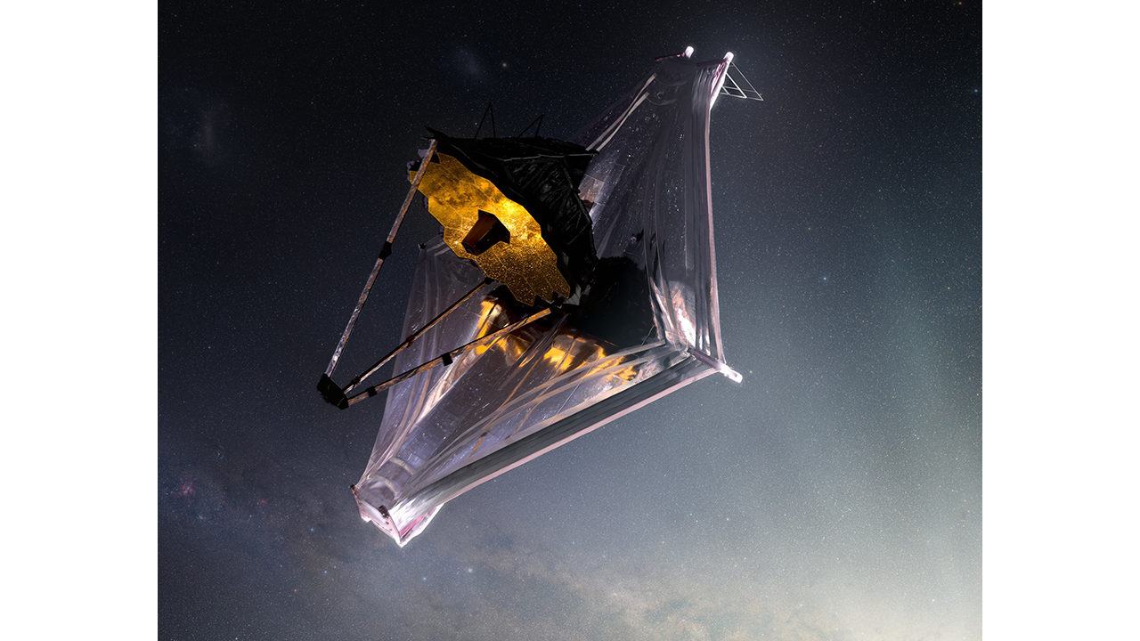
Future Work
The upcoming plan is to combine multiple Stewart Platforms and have them turn towards one point in space.
To replicate the working of James Webb Space Telescope mirrors.
Tune the PID controller to achieve faster convergence without any change in accuracy.

Slide 15
References
https://www.mathworks.com/help/sm/ug/stewart-platform-with-controller.html
https://www.mathworks.com/company/newsletters/articles/creating-a-stewart-platform-model-using-simmechanics.html
https://cdn.instructables.com/ORIG/FFI/8ZXW/I55MMY14/FFI8ZXWI55MMY14.pdf
https://webb.nasa.gov/

Slide 16
Contribution
Task | Member | Contribution
Simulink Model + PID Controller | Tabsheer Askari | 20%
MATLAB data file + PID Tuning | Siddharth Jain | 20%
Stewart Platform Design | Harshal Sanghvi | 20%
Research + Solidworks | Ketan Choudhary | 20%
Equations + Calculations | Harshil Shah | 20%

